Slide 2
Objectives
Understand the use of binary codes to represent characters
Understand the term ‘character set’
Explain the relationship between the number of bits per character in a character set, and the number of characters that can be represented using:
ASCII
Extended ASCII
Unicode

Slide 3
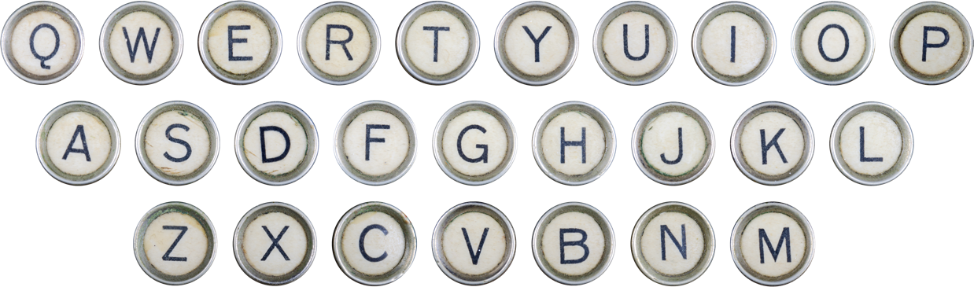
Starter
A computers memory and storage only hold binary 1s and 0s
How might it be possible to store letters with only binary?

Slide 4
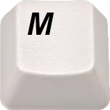


Representing text characters
If a computer understands only 1s and 0s, what happens when the ‘M’ key is pressed on the keyboard?
0 1 0 0 1 1 0 1

Slide 5
Representing characters in binary
Every character on the keyboard is represented by a binary value
Uppercase letters (capitals) have different values from lowercase characters
Punctuation symbols have their own character code
How many characters are there on a standard keyboard?
How many bits would be required to represent this many combinations?

Slide 6
Characters in binary
A keyboard needs to contain
26 lowercase letters
26 uppercase letters
10 numbers
(around) 36 other characters
There are around 98 unique characters that are available on a keyboard
6 bits give 64 different combinations – this isn’t enough
7 bits give 128 different combinations which can represent 128 different characters

Slide 7
Character sets
A character set is a set of letters, symbols and digits that can be represented by a computer
There are two major character sets in use today
ASCII
Unicode

Slide 8
The ASCII character set
ASCII (American Standard Code for Information Interchange) has become the standard code, used worldwide
It was originally developed in the 1960s for representing the English alphabet
It encodes 128 characters into 7-bit binary codes
Characters include numbers 0 to 9, uppercase and lowercase letters A-Z, a-z, punctuation symbols and the space character

Slide 9
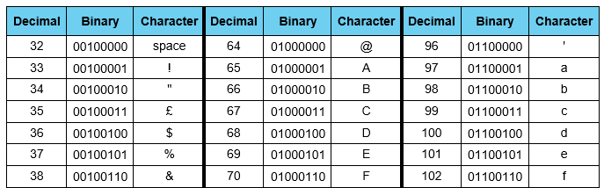
The ASCII character set
What happens if you press ALT+65 on a keyboard?
What character is represented by 0100000 (32)?
What is the ASCII character for the number 7? Is this the same as the binary value for 7?
Why not? What is happening? What does this mean?

Slide 10
ASCII groups and sequences
Character codes are commonly grouped and run in sequence
Numeric characters 0 to 9 run consecutively from 48 to 57 on the ASCII table
A-Z characters are from 65-90 or 01000001 to 01011010
What range does lowercase characters a-z use?
If you know Capital A is 65 or 01000001, what is Capital E?

Slide 11
ASCII character set
ASCII character 32 (010 0000) represents a space
The ASCII character code for ‘7’ is 55
55 (011 0111) is the ASCII character code that represents the character ‘7’
In programming this is very different to the integer 7 which is represented by 0000 0111 (7)
Lowercase characters a-z use 97-122
If A is 65 (0100 0001) then E is 69 (0100 0101)

Slide 12
7- and 8-bit ASCII
Numerous different codes for representing characters have been created, but ASCII is commonly used on PCs
Originally only seven bits were used, but now an eighth bit is used allowing for many more characters such as ©, ® etc.
How many different characters can be encoded using 7 bits, 8 bits or 16 bits?

Slide 13
Character codes
A 7-bit character code (like ASCII) has 128 different characters that can be encoded
An 8-bit character code (like extended ASCII) has 256 different characters that can be encoded
A 16-bit character code has 65 536 different characters that can be encoded

Slide 14
Using the eighth bit
Sometimes it is useful to be able to type special characters like á, à, ®
Here are the codes for some of them:
© Alt+0169 ® Alt+0174 á Alt+0225 à Alt+0224 â Alt+0226 ä Alt+0228
Try out these different character codes

Slide 15
Worksheet 3
Complete Task 1 and Task 2 on Worksheet 3

Slide 16
Programming with text and numbers
The ASCII code for ‘7’ is 011 0111
The binary code for the digit 7 is 0000 0111
When you write a program in Python, for example, you have to specify whether a variable is text or integer
You cannot do arithmetic with characters
If the character represents a number it must first be converted to an integer before any arithmetic can be carried out

Slide 17
Working with string input
In Python, a string will be surrounded by speech marks, whilst an integer won’t be
age = 15 name = "Sam"
If text is entered to a program, it will be as a string unless it is converted
The + symbol will concatenate (join) two strings together
The function int(s) will convert the string named s into an integer

Slide 18
Working with string input
Look at the following program
firstNum = input("Enter first number: ") secondNum = input("Enter second number: ") print(firstNum + secondNum) sum = int(firstNum) + int(secondNum) print(sum)
What is the output if the user enters "3" and "17"?

Slide 19
Working with string input
Look at the following program
firstNum = input("Enter first number: ") secondNum = input("Enter second number: ") print(firstNum + secondNum) sum = int(firstNum) + int(secondNum) print(sum)
What is the output if the user enters "3" and "17"?
Enter first number: 3 Enter second number: 17 317 20

Slide 20
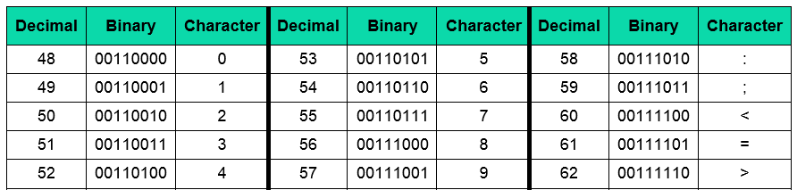
ASCII representation of numbers
Try typing ALT + 55
What is the binary representation of the ASCII character 7? Is this the same as the binary value for 7?
Why not? What does this mean?

Slide 21
Converting ASCII to pure binary
Clearly, we cannot do arithmetic with ASCII characters
Programming languages deal with the input of numbers in different ways
In some languages, variables have to be declared as type char, string, integer, real etc. at the beginning of the program
In other languages such as Python, all data is input as string, and if it is to be regarded as an integer, it has to be converted using an inbuilt function
e.g. xString = input (“Enter an integer: ”)
x = int(xString)

Slide 22
Using different alphabets
To represent other characters for different languages, a new code allowing for many more characters is needed
Unicode was developed to use 16 bits 65 536 possible combinations
The 32 bit version gives 4 294 967 296 (over 4 billion) possible combinations

Slide 23
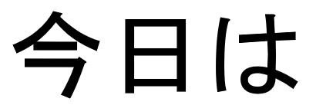
Unicode
In Japanese, konnichiwa is used as a greeting meaning ‘good day’
In Unicode this is written as three 16-bit characters
How many bytes does the English ‘good day’ require in ASCII?
How many bytes does the Japanese require in Unicode?

Slide 24

Unicode
‘good day’ requires 8 bytes to store
今日は requires 6 bytes to store (3 characters × 2 bytes)
Unicode is also used to store emoji
‘e’ is Japanese for picture
‘moji’ is Japanese for character or alphabet
Smiling face with sunglasses Unicode: 1F60E

Slide 25
Worksheet 3
Complete Task 3 on Worksheet 3

Slide 26
Plenary
Work in a pair to answer the following questions
How many bits are in extended ASCII?
How many characters does this allow for?
How many bytes are in Unicode?
If ‘f’ has the ASCII code 102, what is the ASCII code for ‘g’?
How many bytes are needed to store “Hello everyone.”?

Slide 27
Plenary
How many bits are in extended ASCII? 8 bits
How many characters does this allow for? 256
How many bytes are in Unicode? 16-bit has 2 bytes, 32-bit has 4 bytes
If ‘f’ has the ASCII code 102, what is the ASCII code for ‘g’? 103
How many bytes are needed to store “Hello everyone.”? 15 letters (remember space and the full stop)

